Slide 1
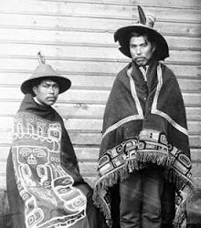
Native Americans
Haida tribe from the Pacific Northwest
by
Holly Tipping

Slide 2
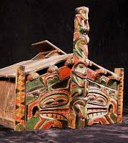
HOMES
The Haida Indians lived in rectangular cedar-plank houses with bark roofs. Usually these houses were large. Sometimes they could be up to 100 feet long and in each one there could be as many as 50 people living from the same families of the same clan. Here is a picture of a Native American house like the ones Haida Indians used. Today, old-fashioned buildings like these are still made from cedar wood, but they are only used for special occasions. Haida people live in modern houses and apartment buildings, just like us.

Slide 3
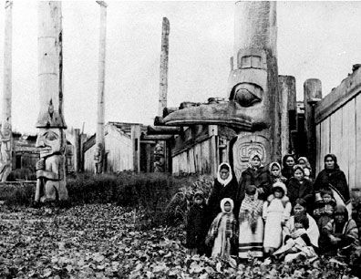
FAMILY LIFE
In the Haida tribe family life was different to ours.
Men were responsible for all the hunting and fishing. also did all the building and carving .
Women stayed near the home, doing work on land.
The women were responsible for all of the chores in the house. They cleaned, cooked, and looked after the children.
Women dug for clams and shellfish and collected berries from nearby forests.
The women also pounded and softened cedar bark for weaving and making clothes.

Slide 4
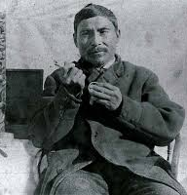
TRIBAL STORIES /FAMOUS MEMBERS
Tribal stories
There were lots of tribal stories in the Haida tribe. My favourite was How Raven brought light to the world. This story was about a Raven who was sick of bumping into things in the dark. One day the Raven bumped into a house that an old man and his daughter lived in. The Raven saw light in the house. The Raven went in and stole the light ,and that was how light came to the world.
Famous Members
The leader of the Haida tribe was Edenshaw. Council of the Haida Nation was made of the President - kil tlaats 'gaa (Peter Lantin), vicepresident Ginn wadluu un uula isdaa ayaagang (Trevor Russ) and others.

Slide 5
FOOD
What did they eat? When the Haida tribe needed food, they didn’t go the grocery store like us. They would hunt, fish and collect plants. In the summer they would eat elk, bear, salmon, even mountain goats. Food could be found in the forest and the ocean. The easiest way to hunt seals was to sneak up on the seal that was basking in the sun, then hit it the seal on the head with a club. The Haida cooked their food by using heated rocks inside cedar boxes or heated rocks inside baskets full of water. In the winter when food was not easily found, they would eat the foods they saved like dried salmon that they caught in the summer.
How they prepared their food The Haida ate their meat either baked, steamed or boiled. To do this they made a box out of cedar, put water and the food in it. They also heated rocks inside baskets full of water.

